Slide 1
Figures for ABC official documentation
2024-08
Aki

Slide 2
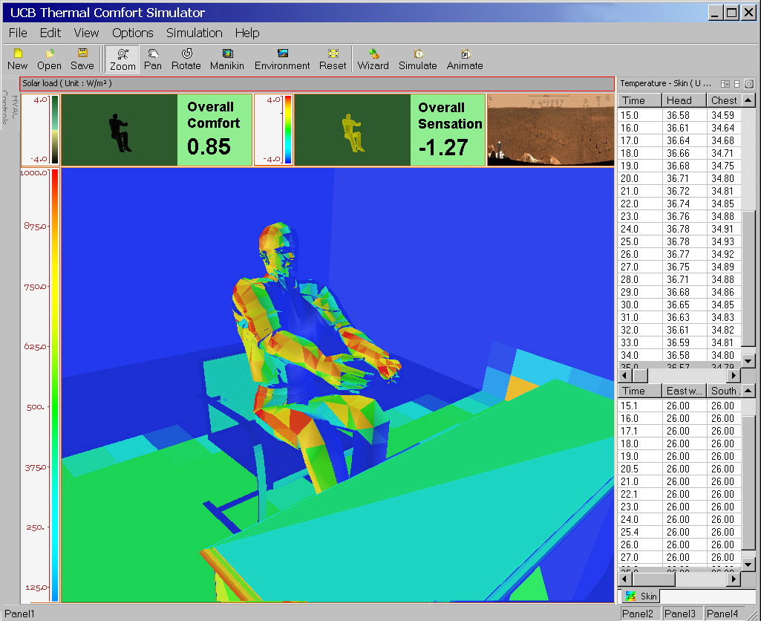
ABC model
(a)
(b)
・ Body (height, sex, age, race, etc.)
・ Thermal environment (Air tye
Input
Thermal physiology model
Output
Skin temperature, Core temperature, etc.
Input
Thermal comfort model
Output
Thermal sensation, Thermal comfort

Slide 3
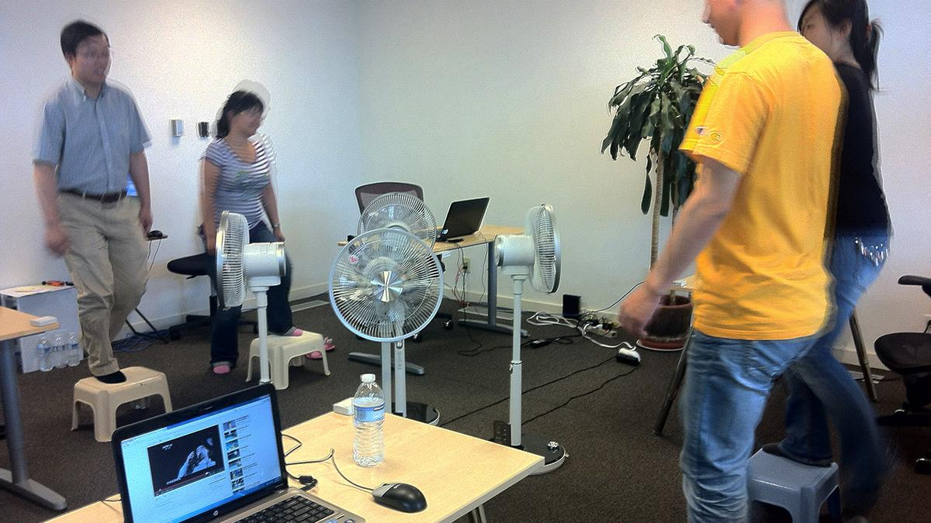
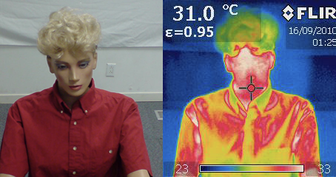
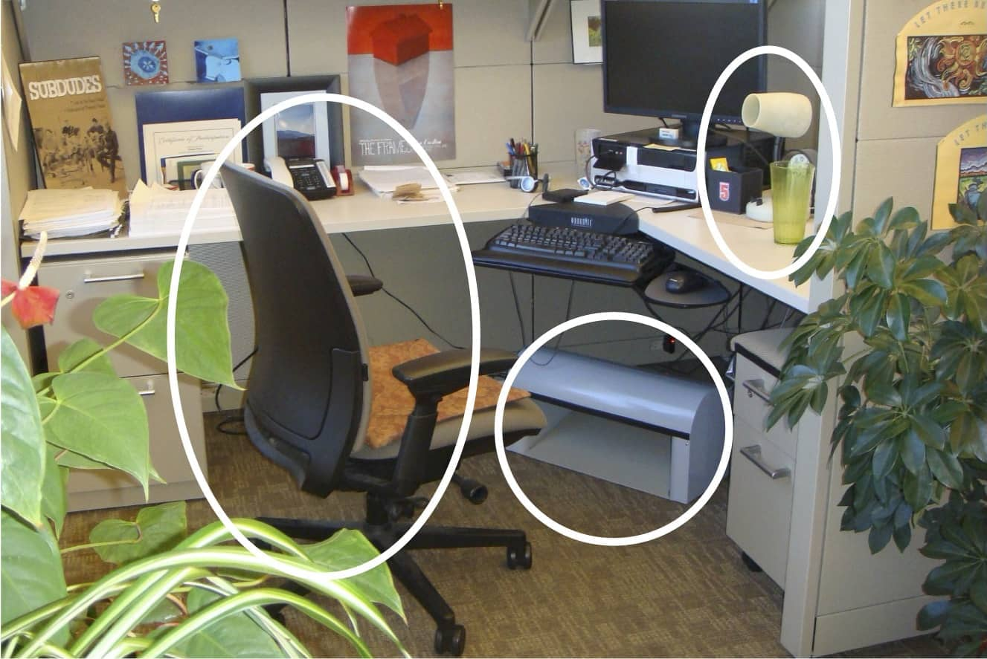
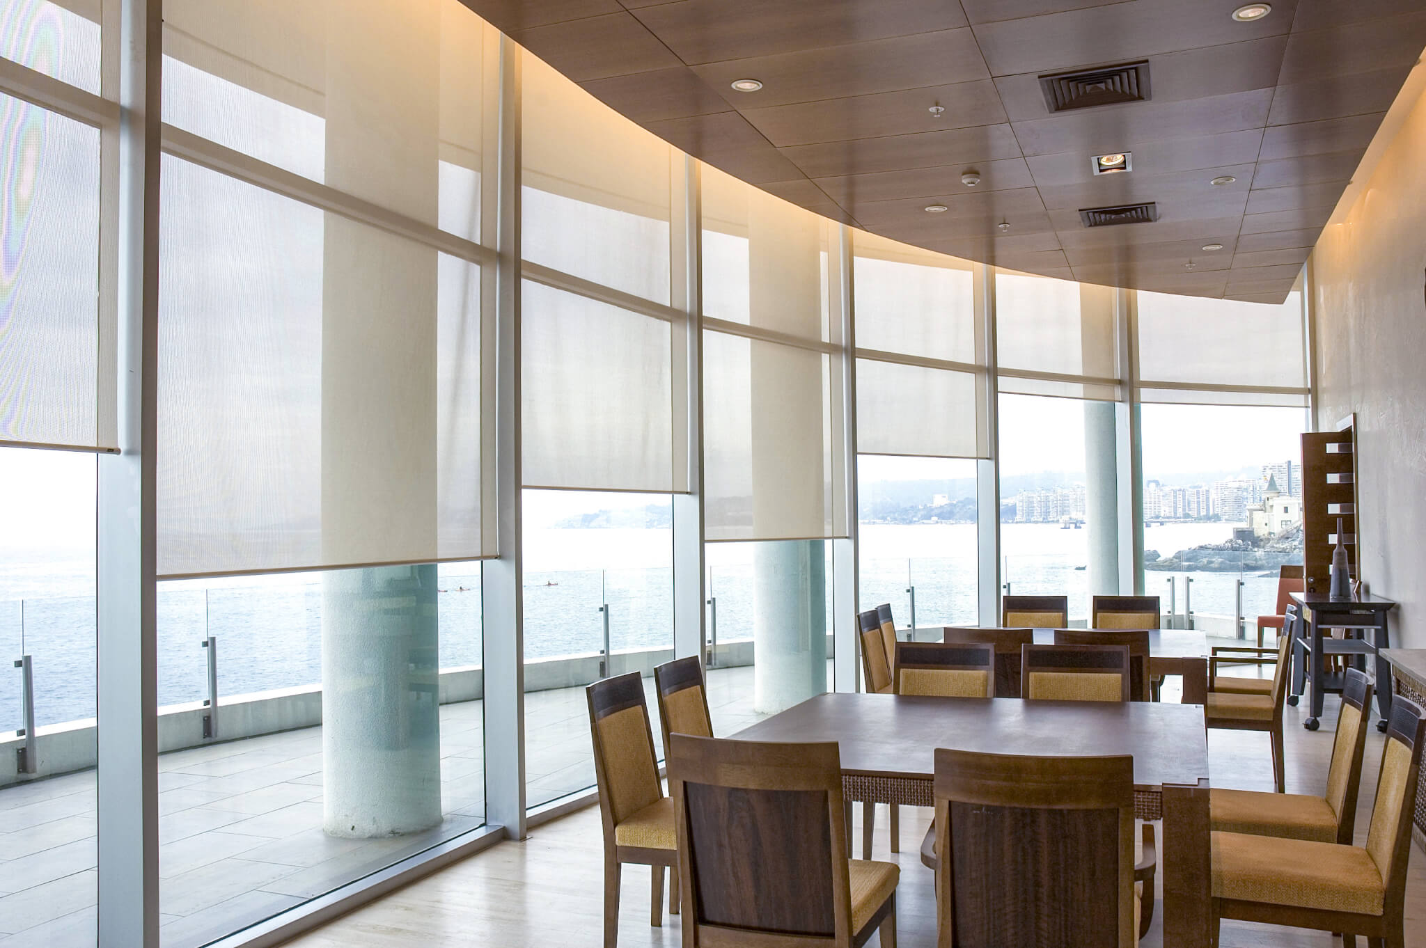
(a)
(b)
(a)
(b)

Slide 4



Simulation flow
Input JSON file
ABC model
Output JSON file
Comfort
Ta=25C,
MRT=30C,
RH=40%
…
Physiology
Tsk=34C,
Sens=+1,
Comf=-1
…

Slide 5
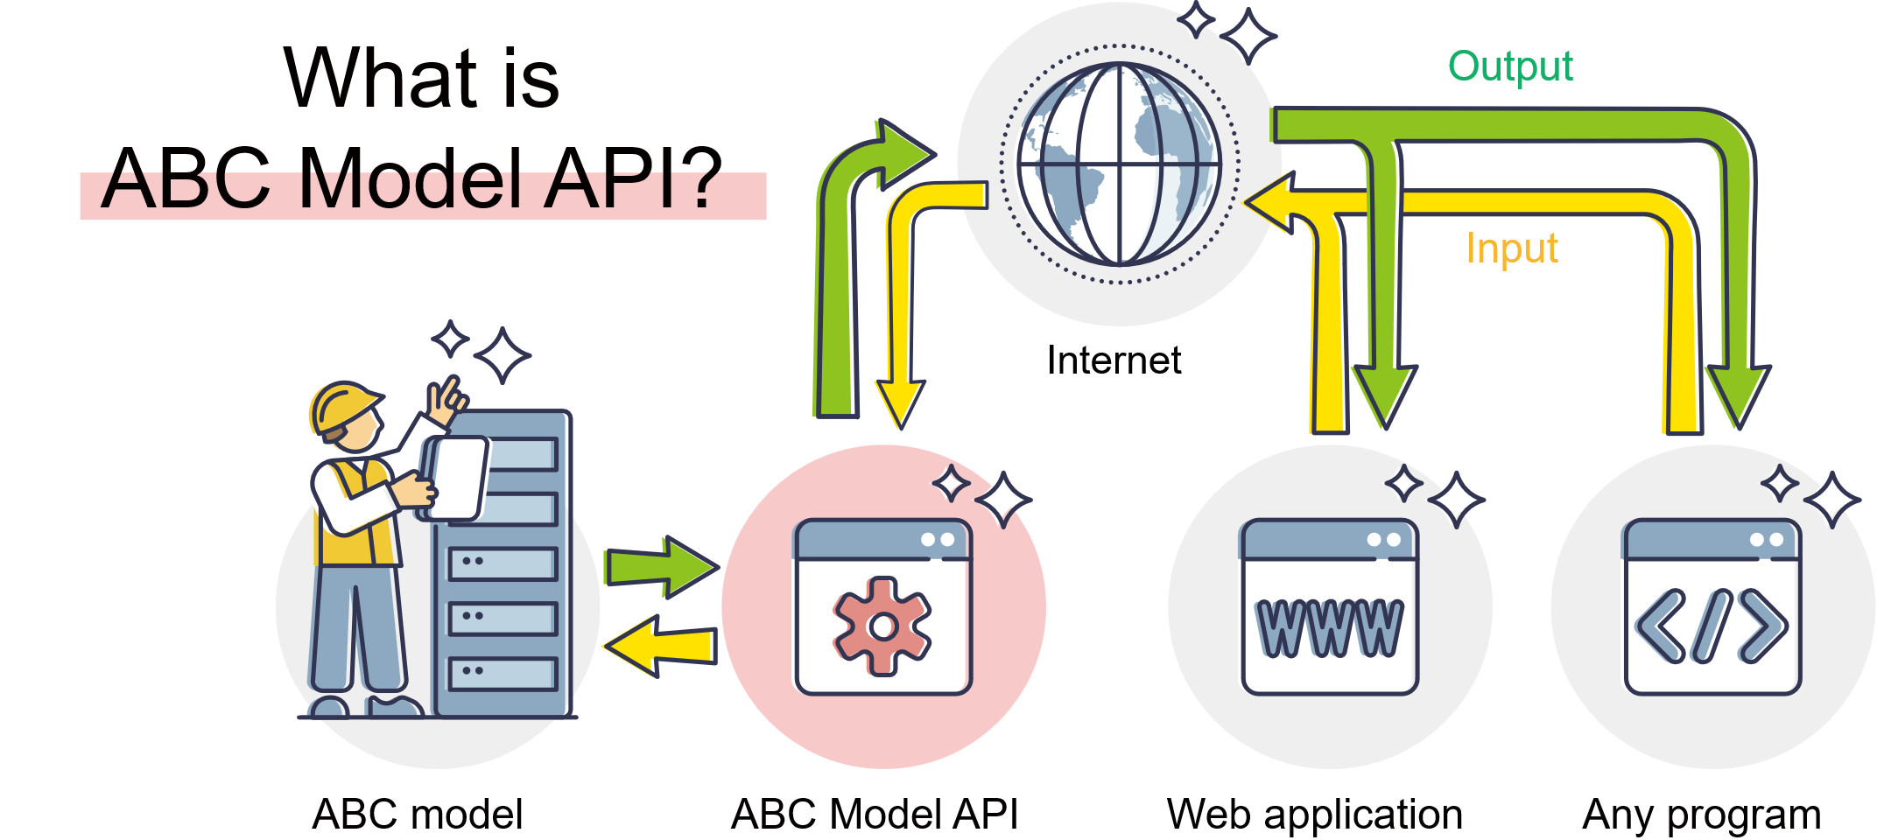
API flow

Slide 6





Slide 7
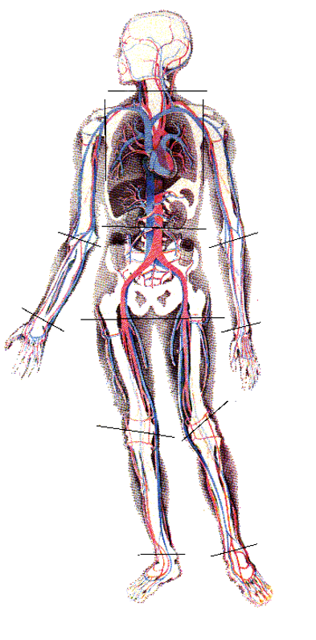



Respiration
Solar radiation
Evaporation
Thermogenesis,
Convection
Clothing
Radiation

Slide 8
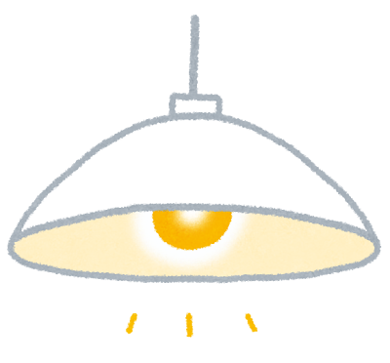
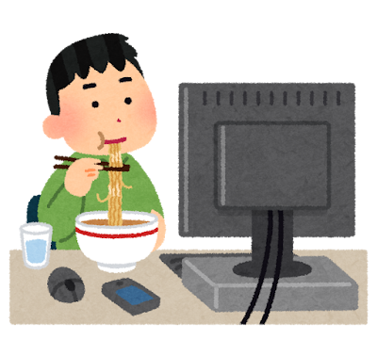

What is thermal node models?
あああ
Inside
Outside
Heat capacity: C [J/K]
Area: A [m²]
Heat transfer: q [W]
Temperature: T_{in} [ºC]
Temperature: T_{out} [ºC]
Heat transfer coefficient:
h [W/m²*K]
Heat gain: Q [W]

Slide 9
Human body temperature and thermoregulation
Hypothermia
Shivering
Thermally neutral
Sweating
Hyperthermia
Metabolic rate
Core temp.
Blood flow
Skin temp.
Lower limit
Upper limit
Ambient temperature

Slide 10
Thermal Physiology
(local and mean skin temperatures)
Local Thermal Sensation
Local Thermal Comfort
Overall Thermal Sensation
Overall Thermal Comfort

Slide 11
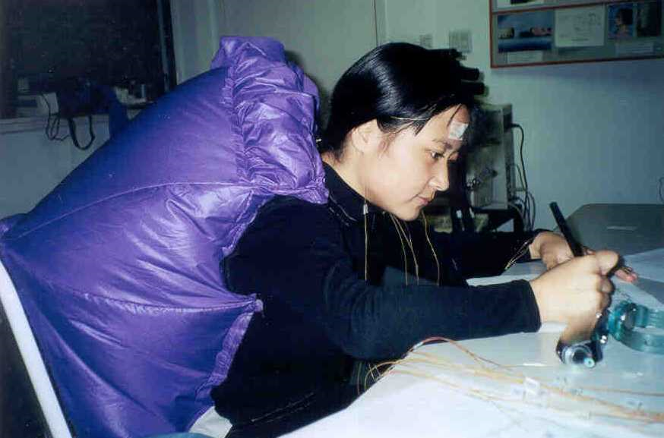
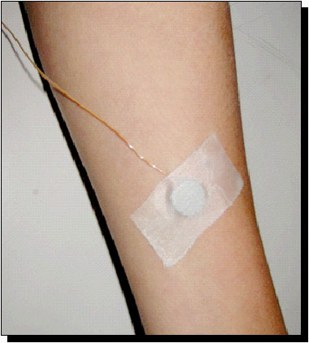
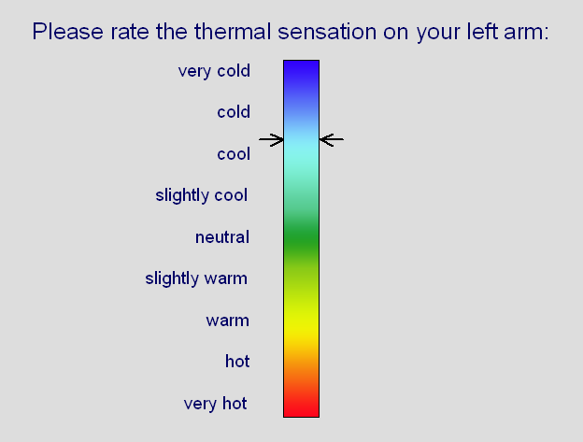
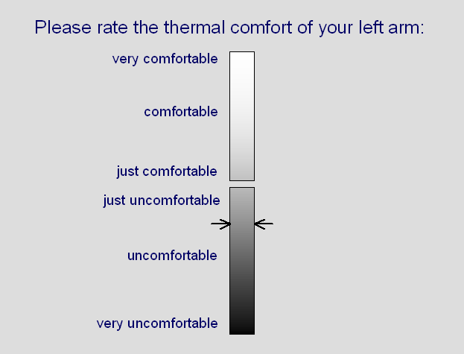
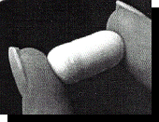
(a)
(b)
(c)
(d)
(e)

Slide 12
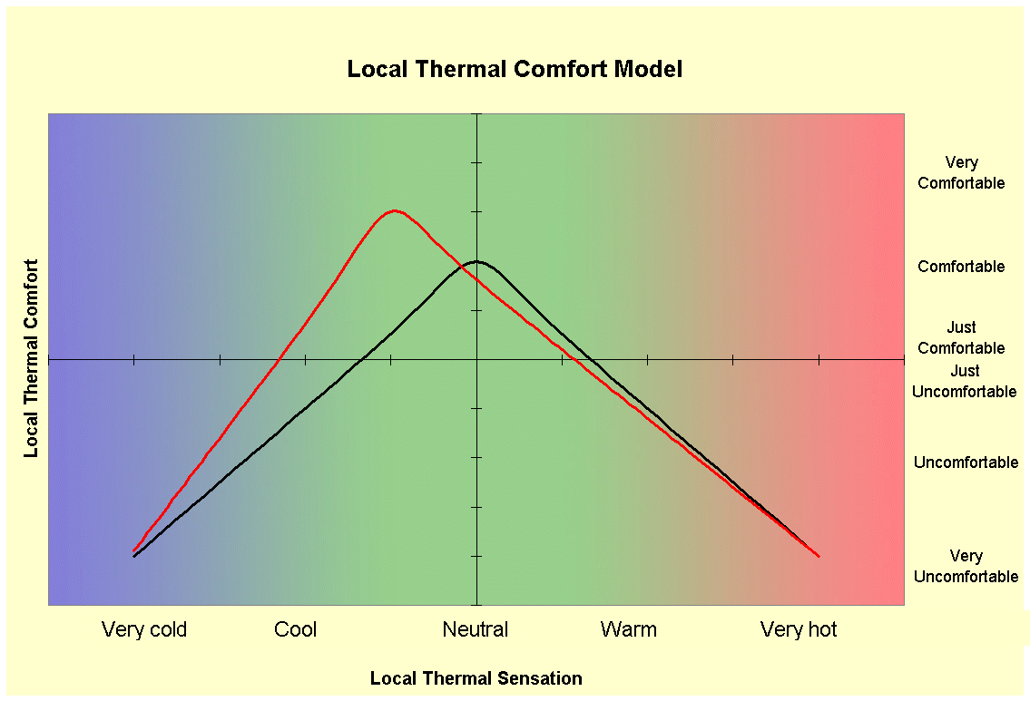
4 model components
Physiology
Local Thermal Sensation
Local Thermal Comfort
Overall Thermal Sensation
Overall Thermal Comfort

Slide 13
Very hot
4
Warm
whole body colder
Local sensation [-]
0
Neutral
-10
-5
0
5
10
Cold
whole body warmer
Very cold
-4
T_{sk[i]} – T_{sk,set[i]} [ºC]

Slide 14
Very comfortable
Basic function
Comfortable
Warm overall
Cold overall
Just comfortable
Local thermal comfort [-]
Just uncomfortable
Uncomfortable
Very uncomfortable
Very cold
Cool
Neutral
Warm
Very hot
Local thermal sensation [-]

Slide 15
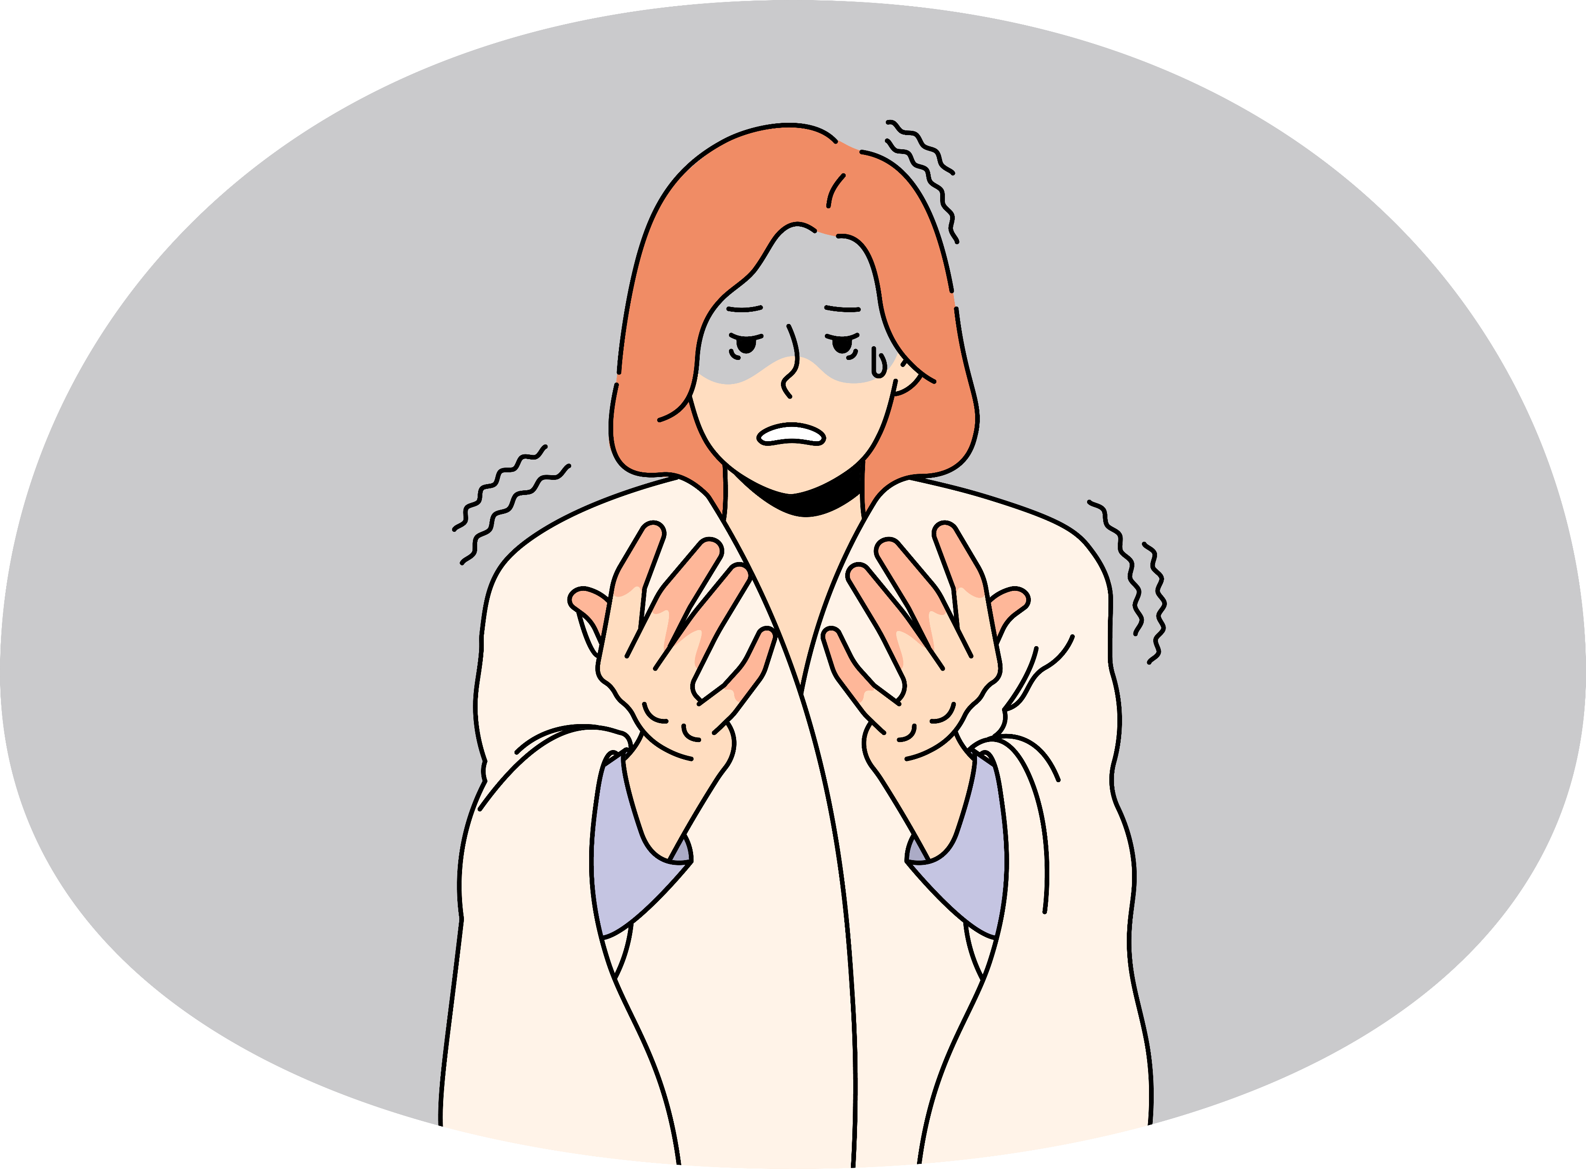


No opposite sensation model
Opposite sensation model
Complainant model
Gradual model
I am comfortable.
I feel cold but my hands are warm.
My hands are too cold!

Slide 16
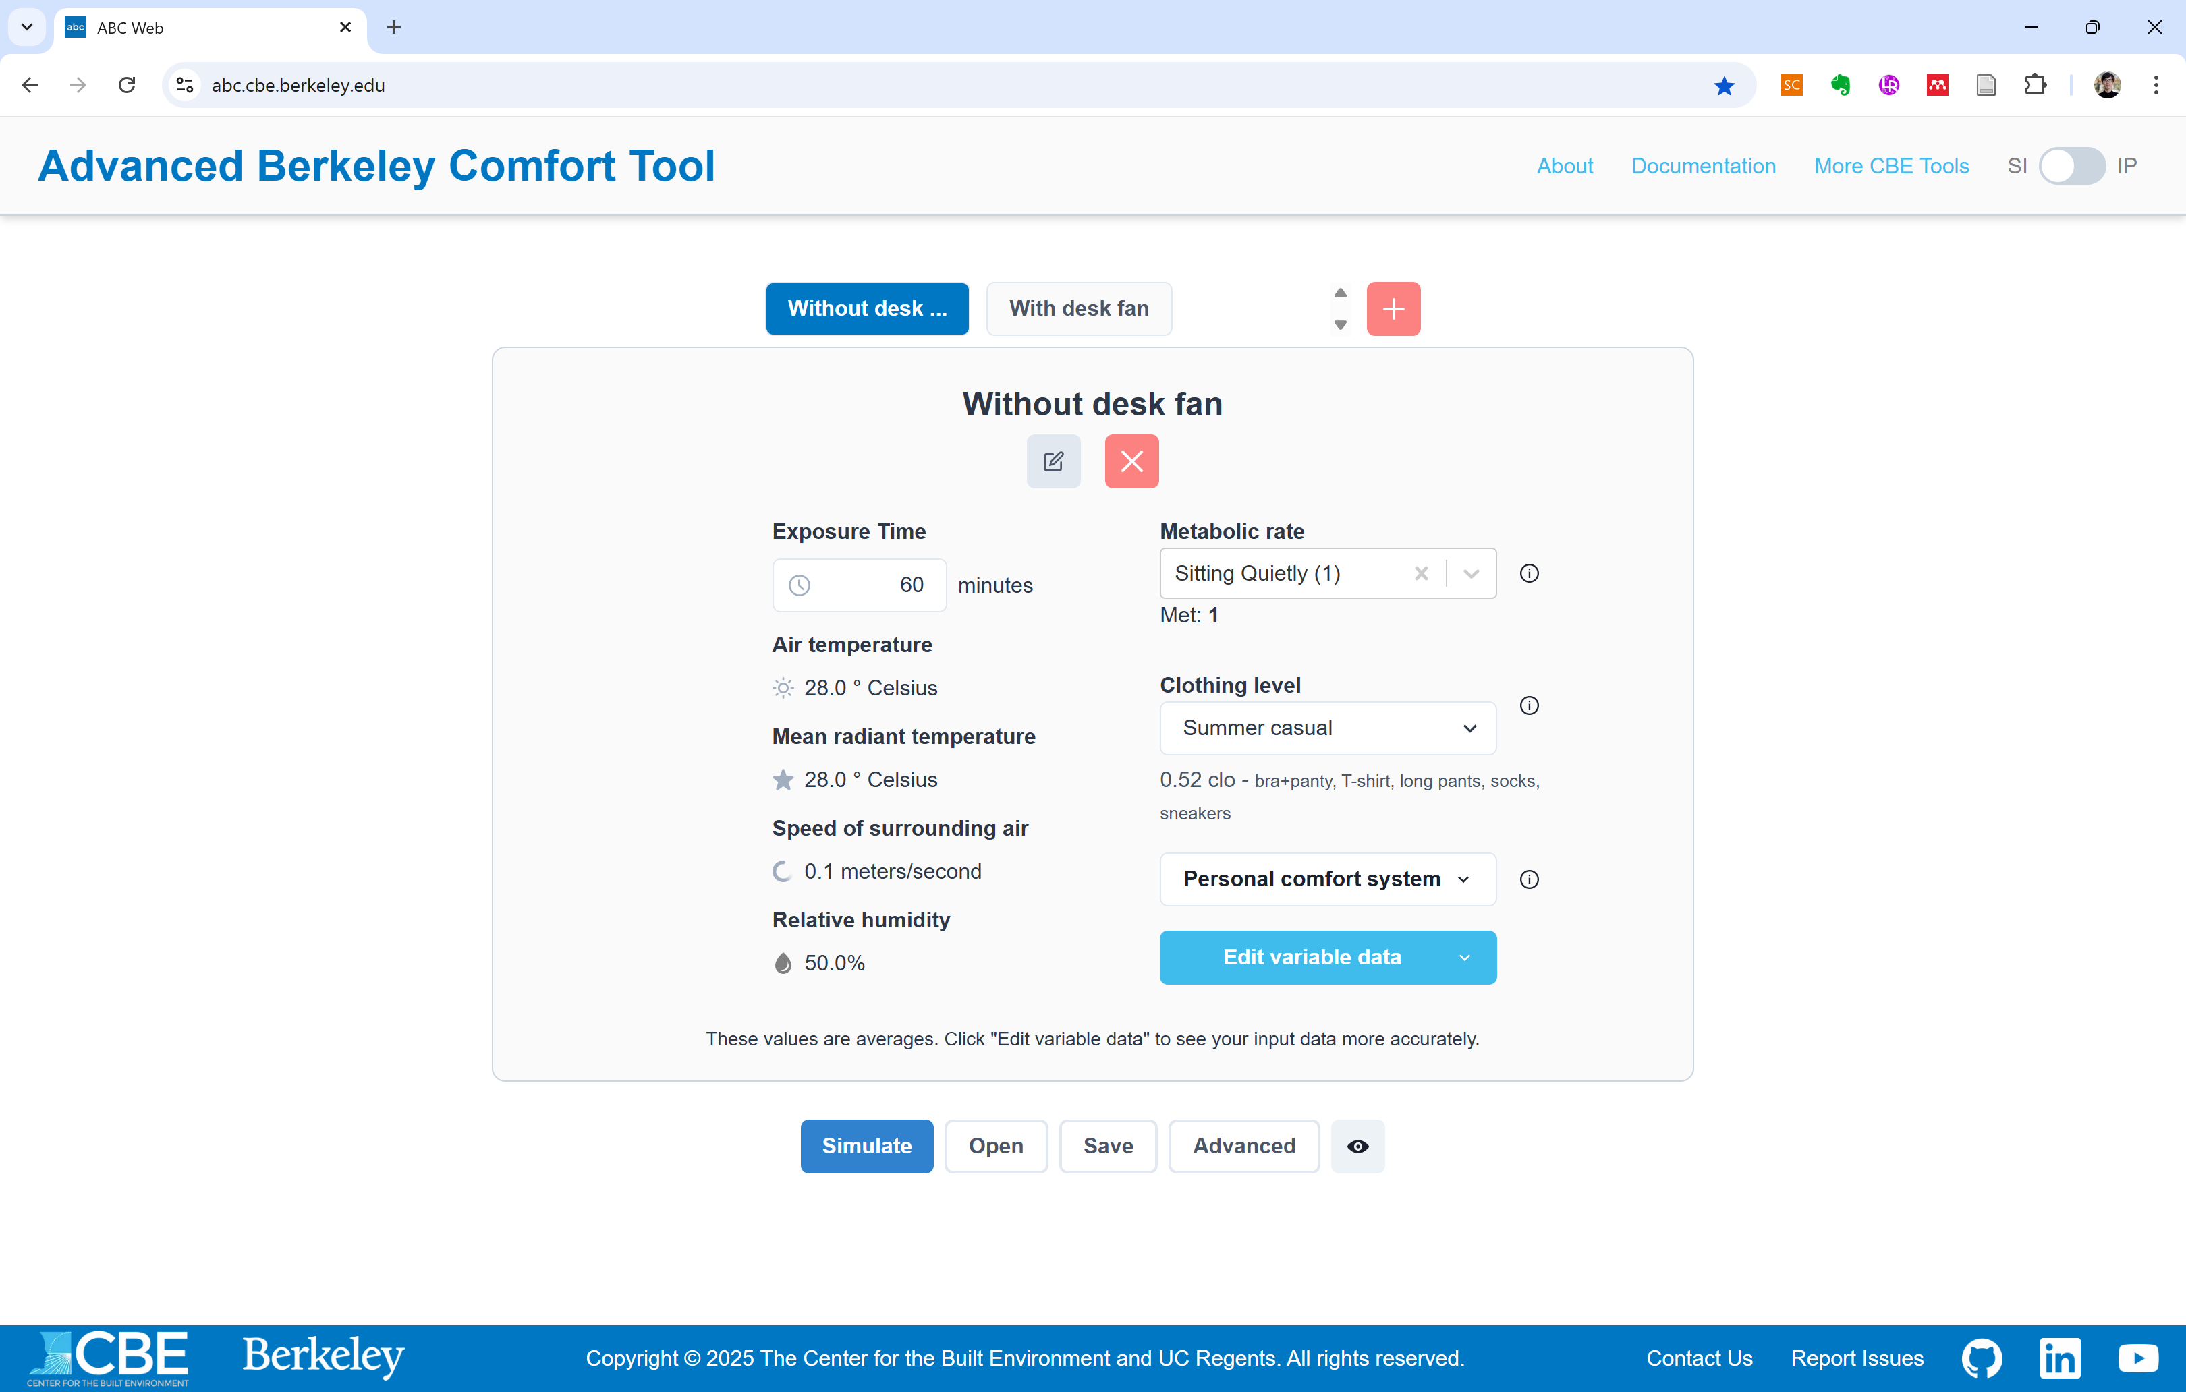
Set the number of conditions
Edit / Delate condition names
Input conditions
Simulation / File import / File export / Advanced settings

Slide 17
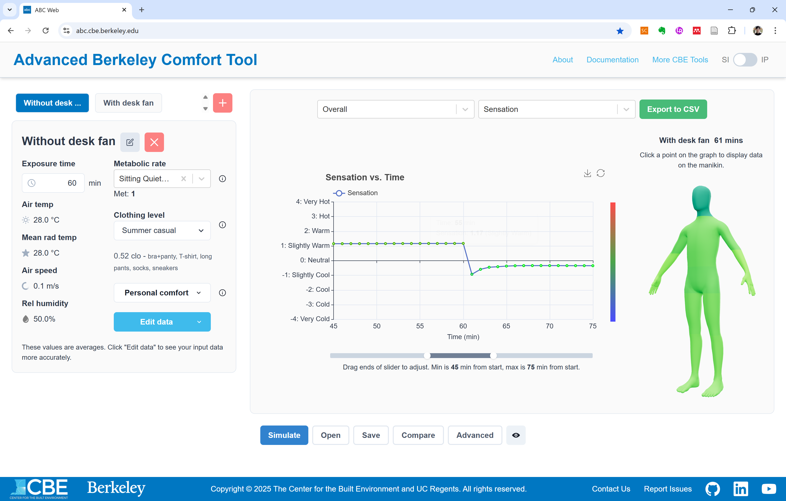
Body segment selector
Result item selector
CSV export
Time-series results
3D manikin
Input section

Slide 18
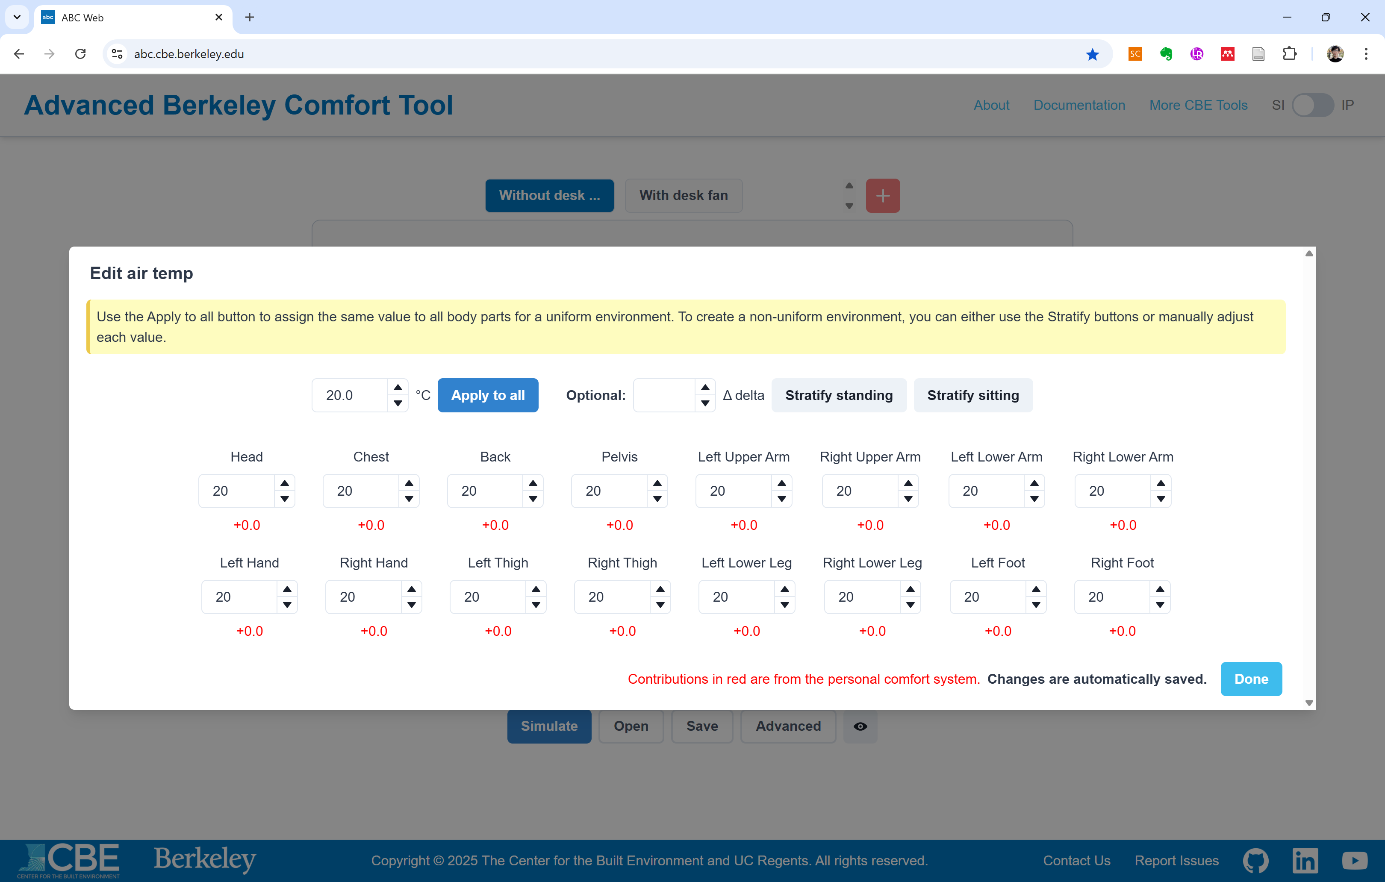

Slide 19
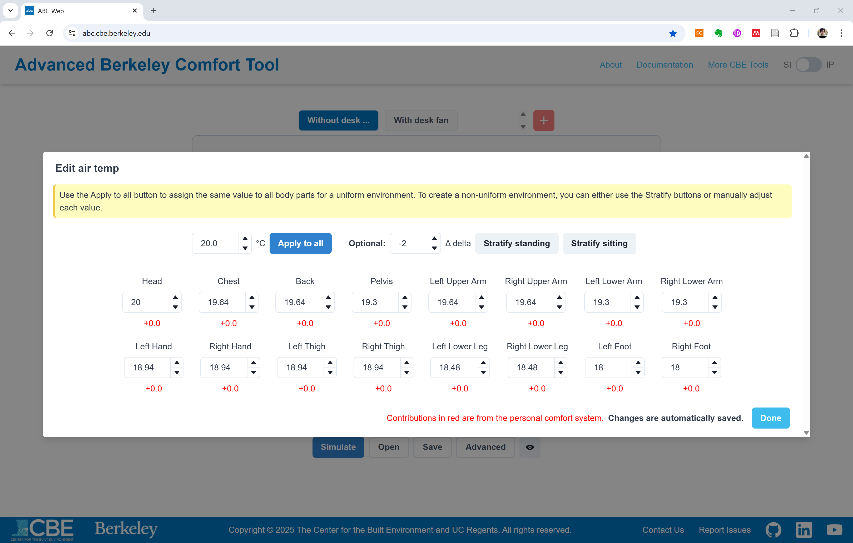

Slide 20
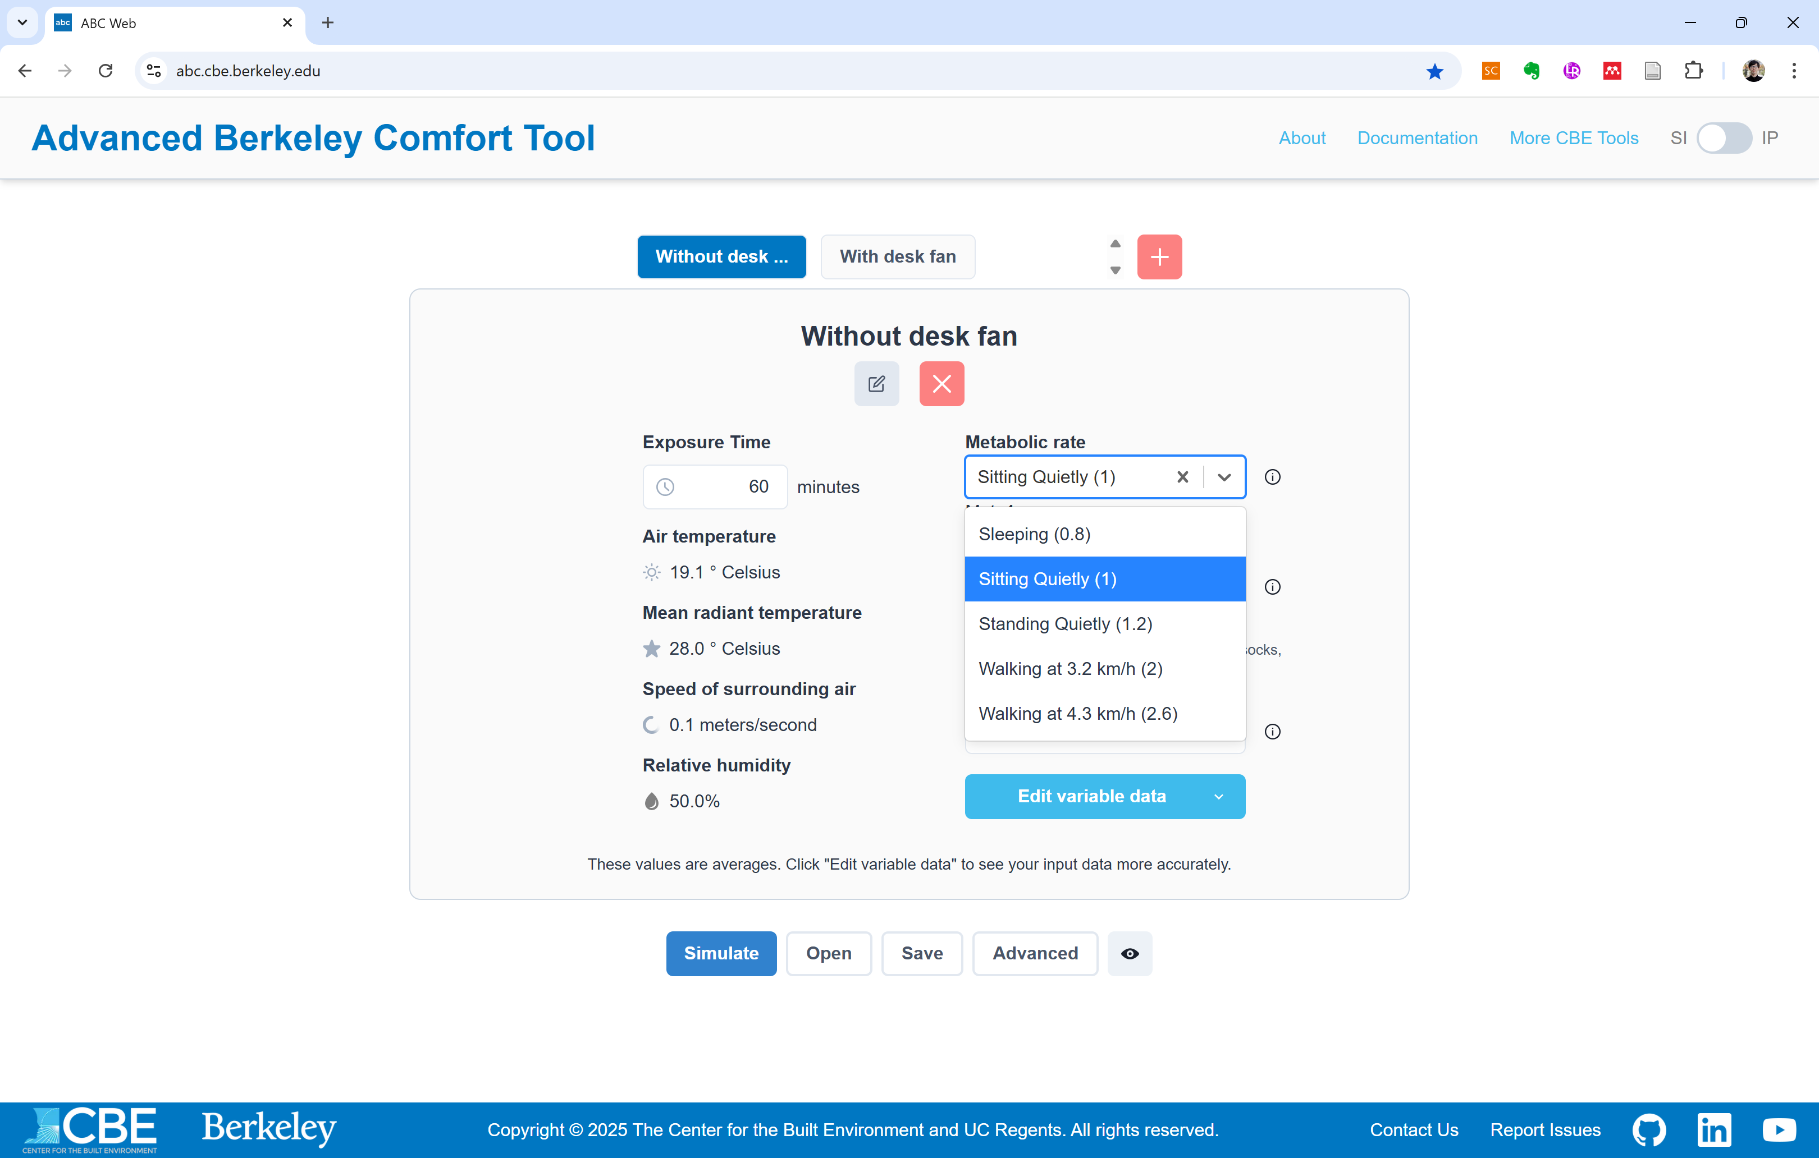

Slide 21
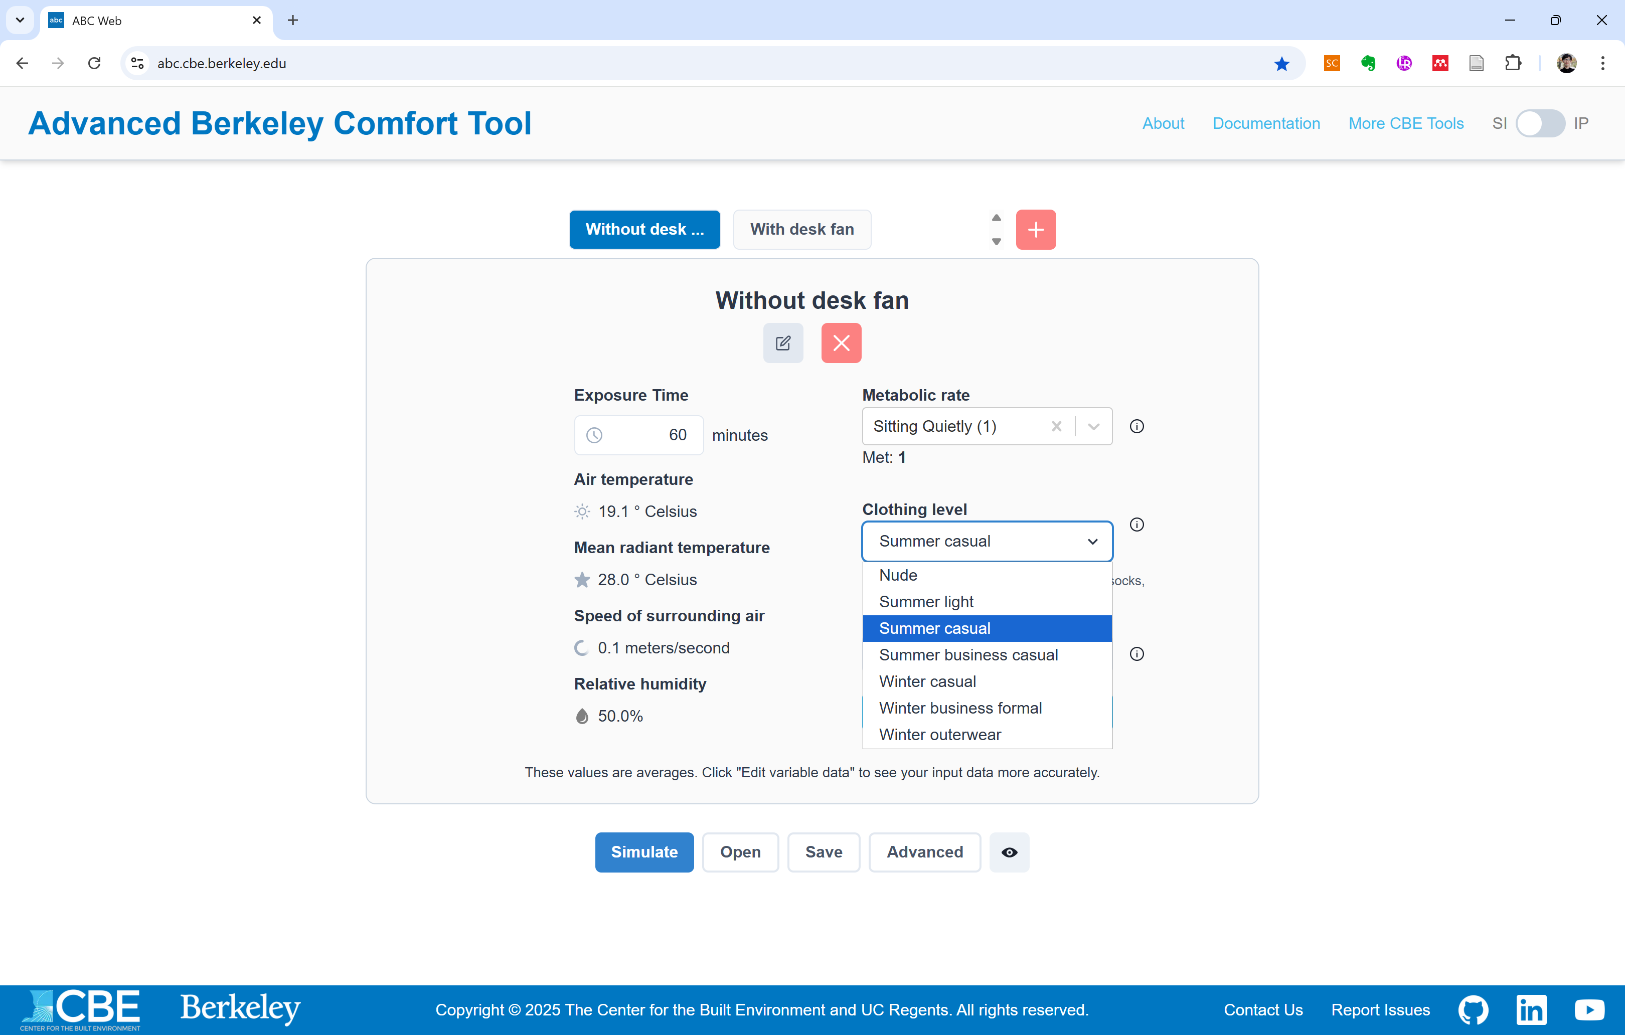

Slide 22
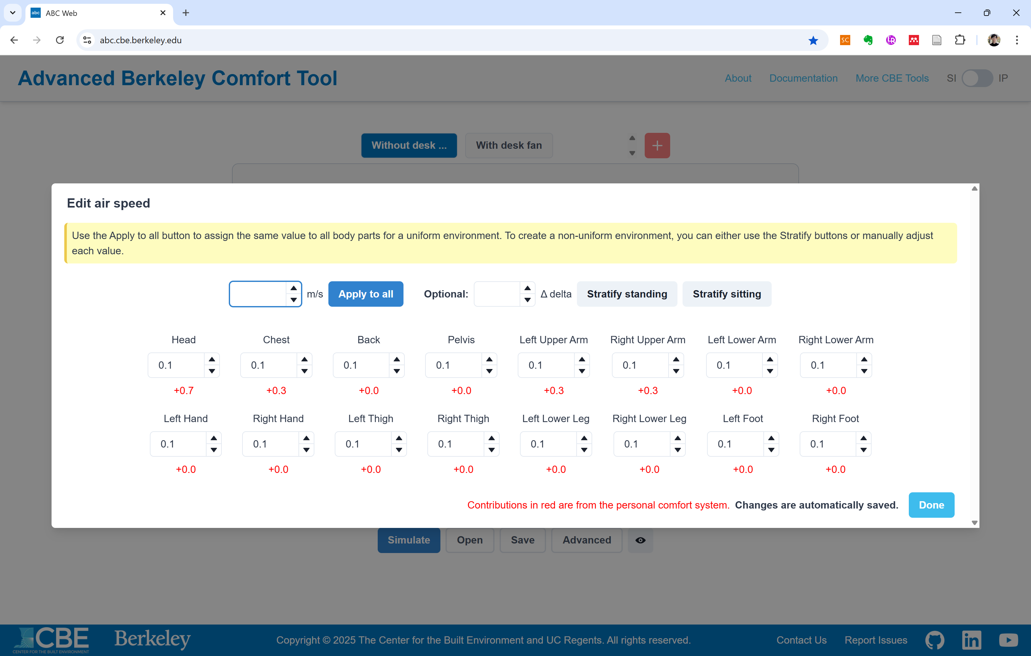

Slide 23
CSV export
File import / File export

Slide 24
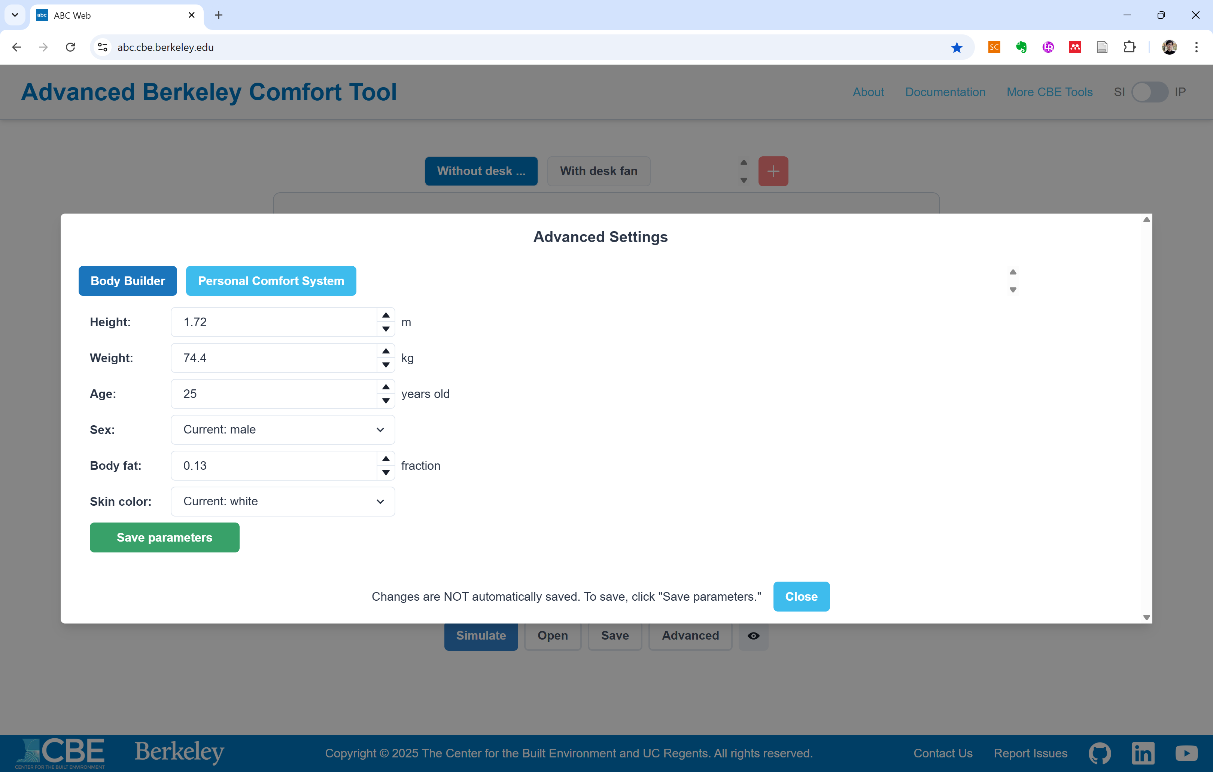

Slide 25
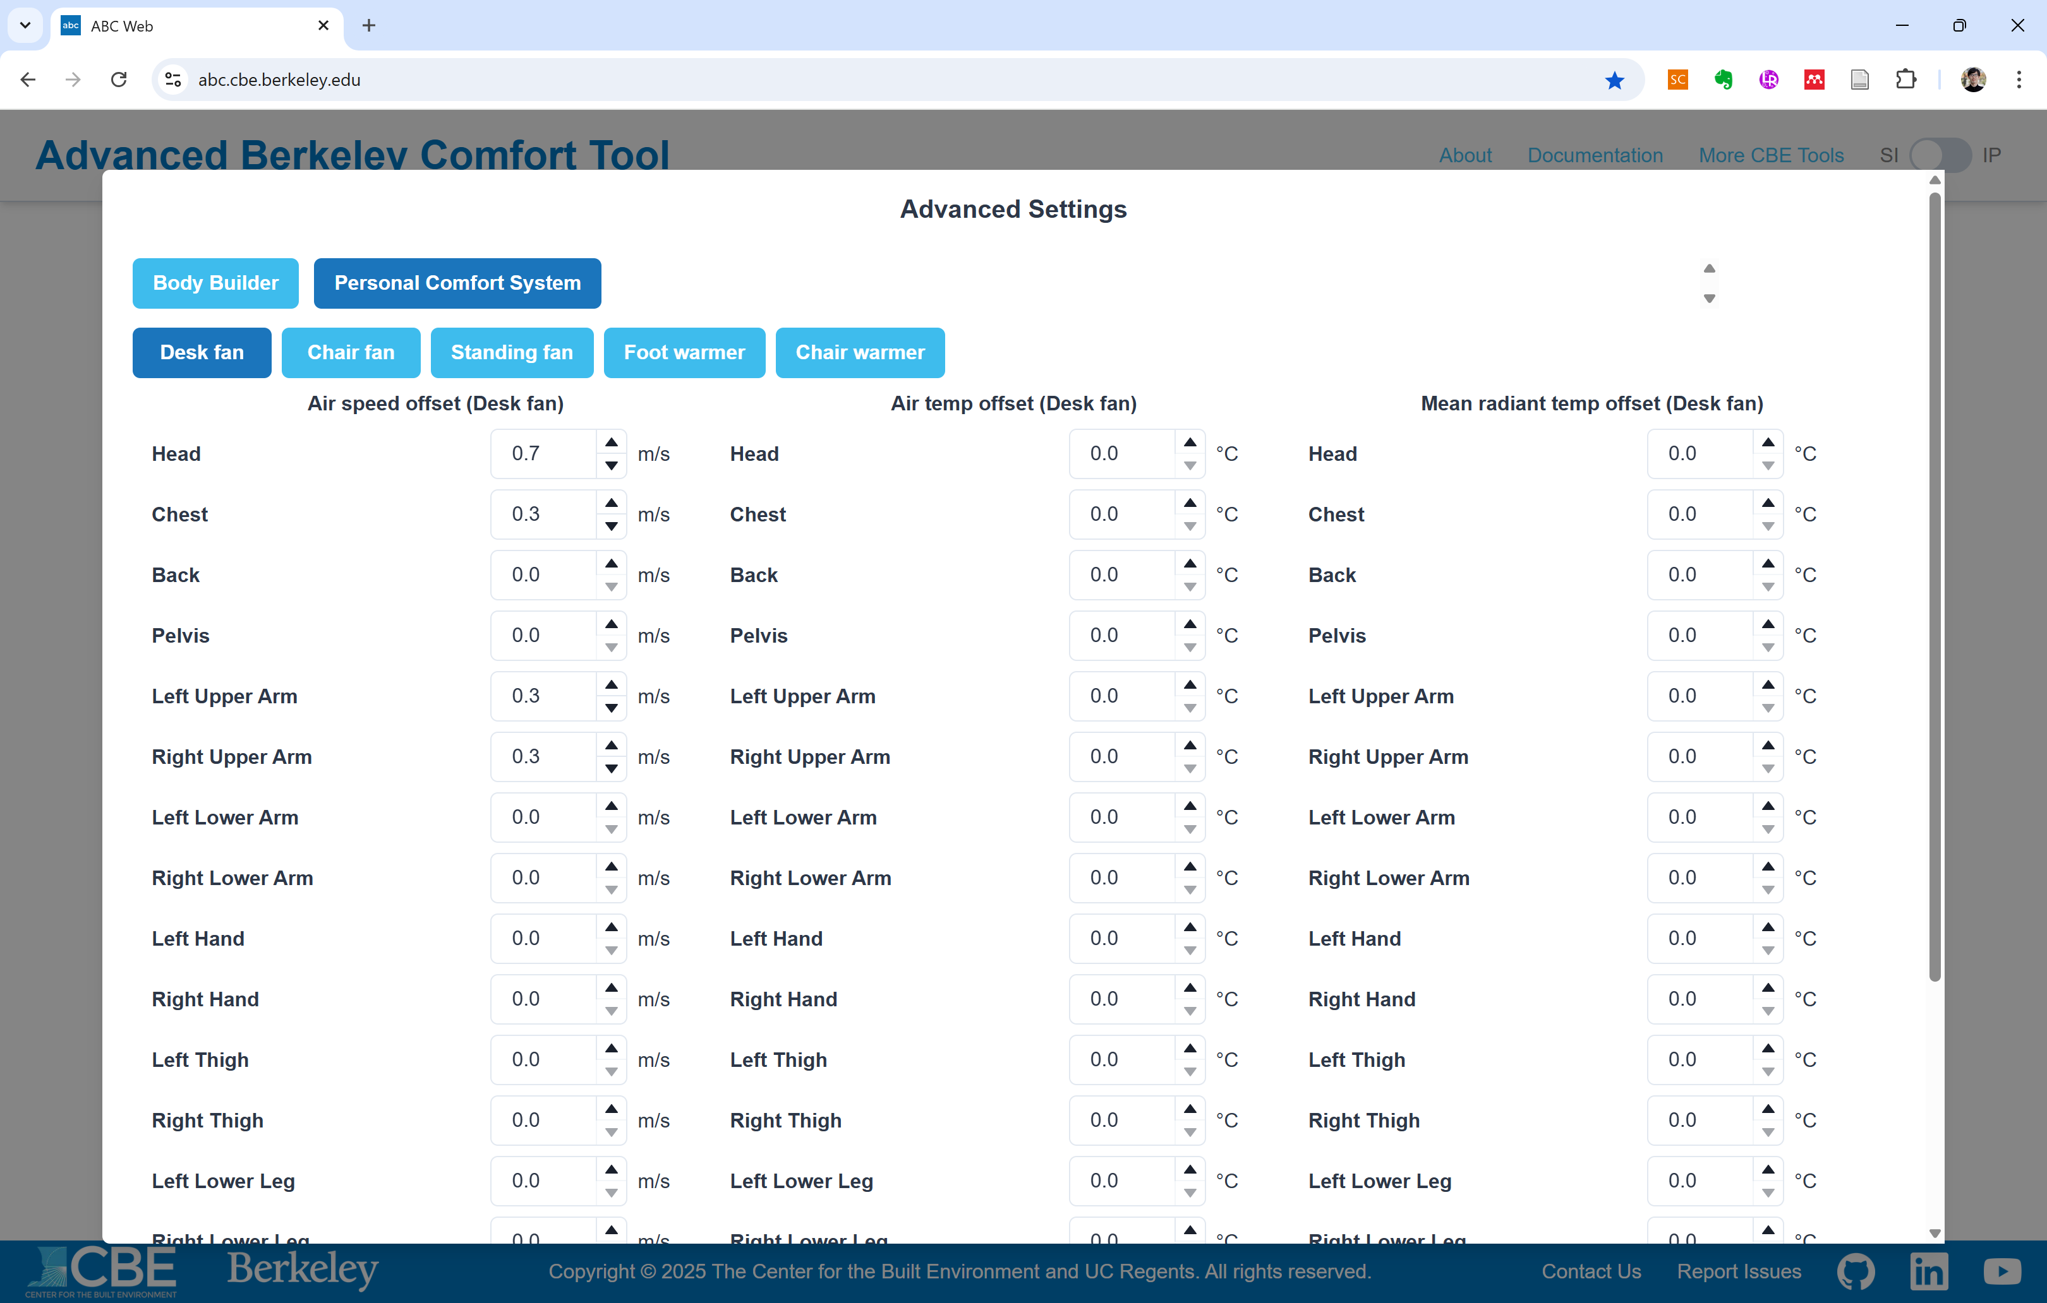

Slide 26
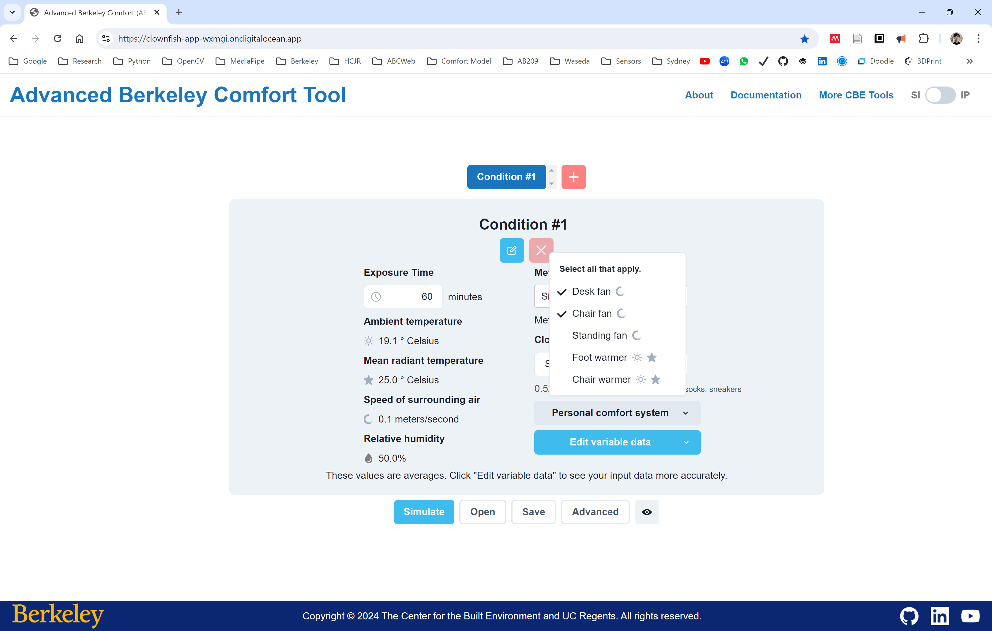

Slide 27
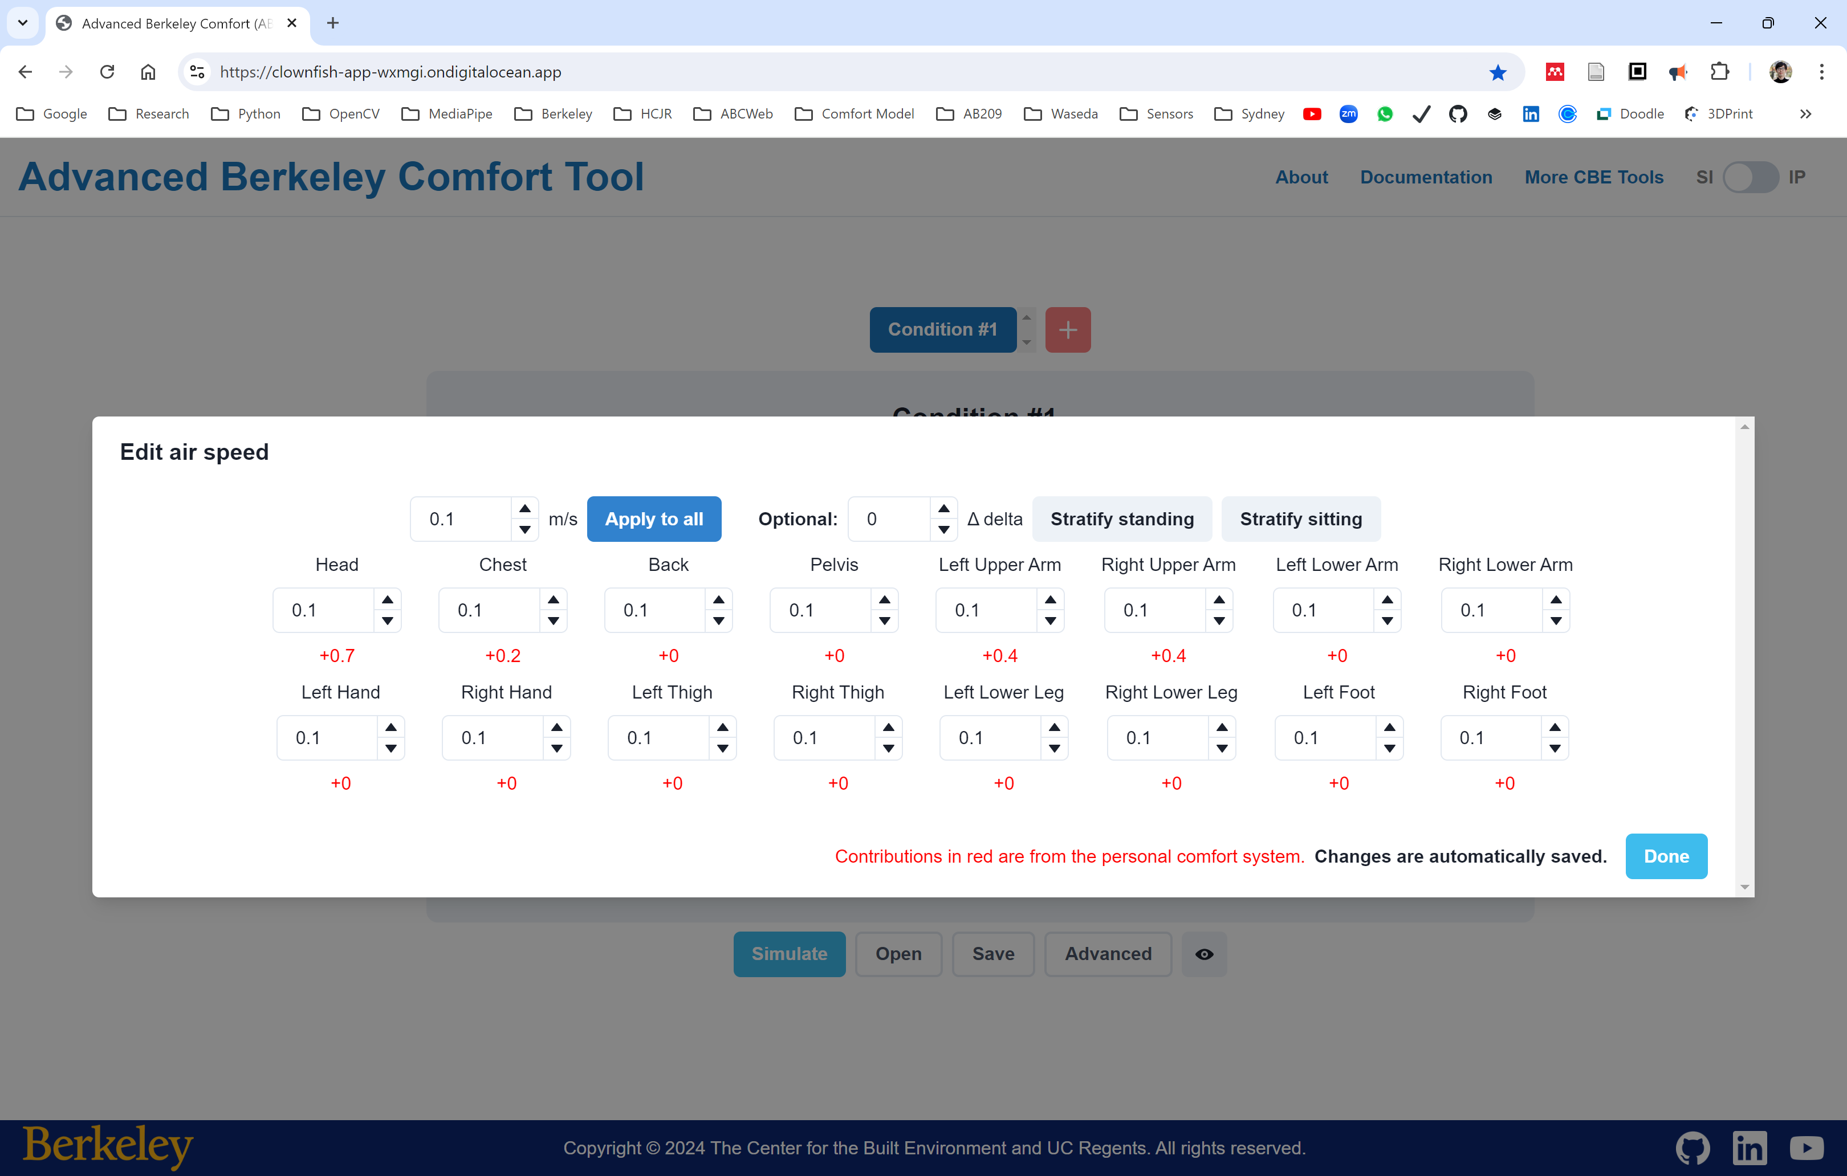

Slide 28
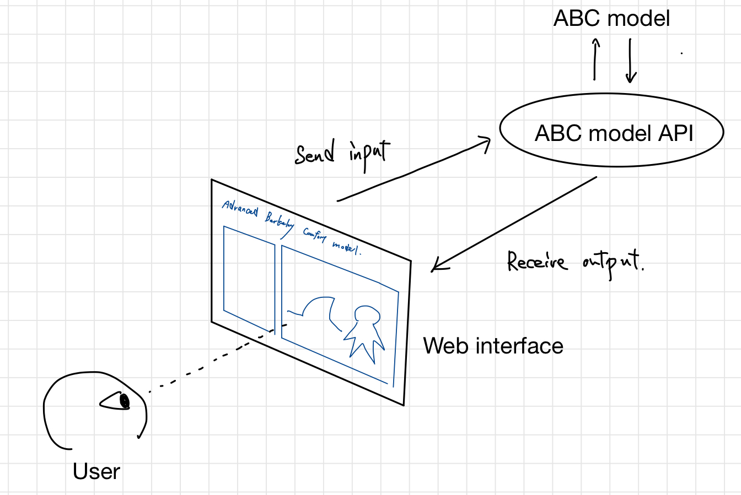
ABC web

Slide 29
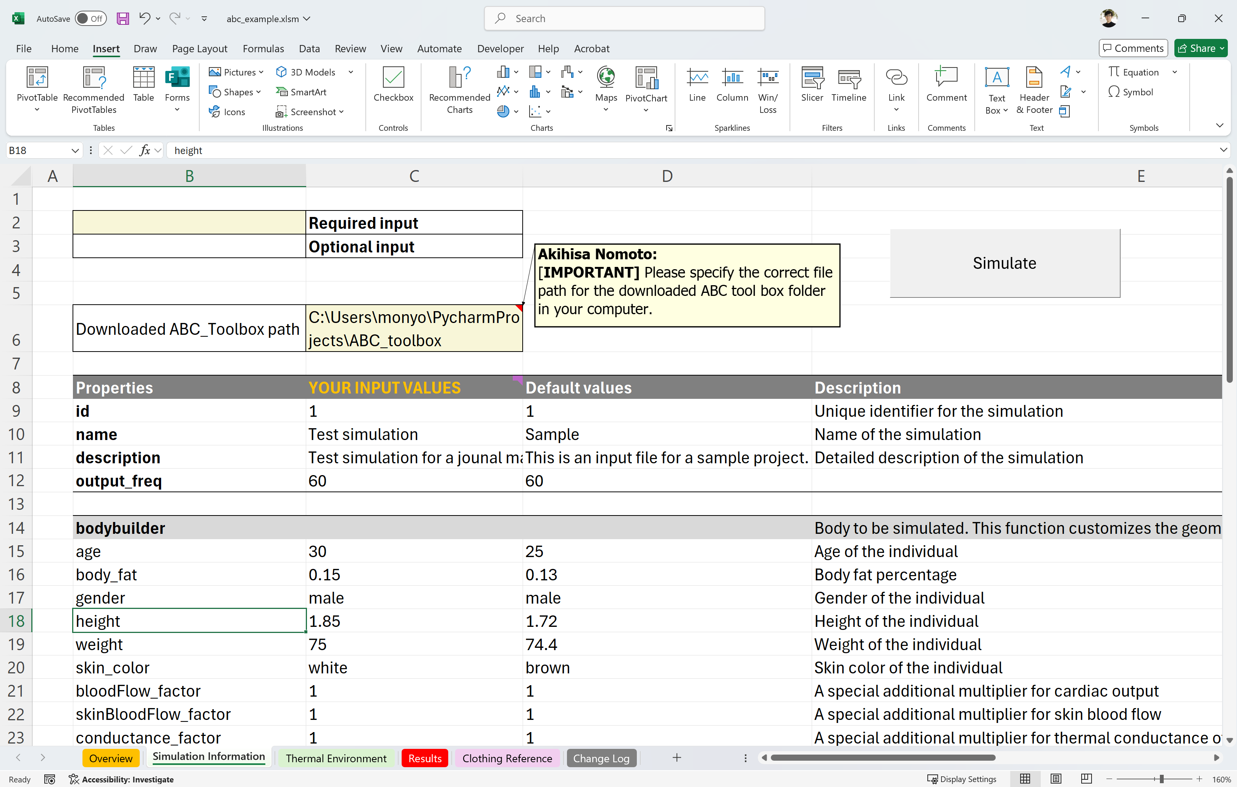
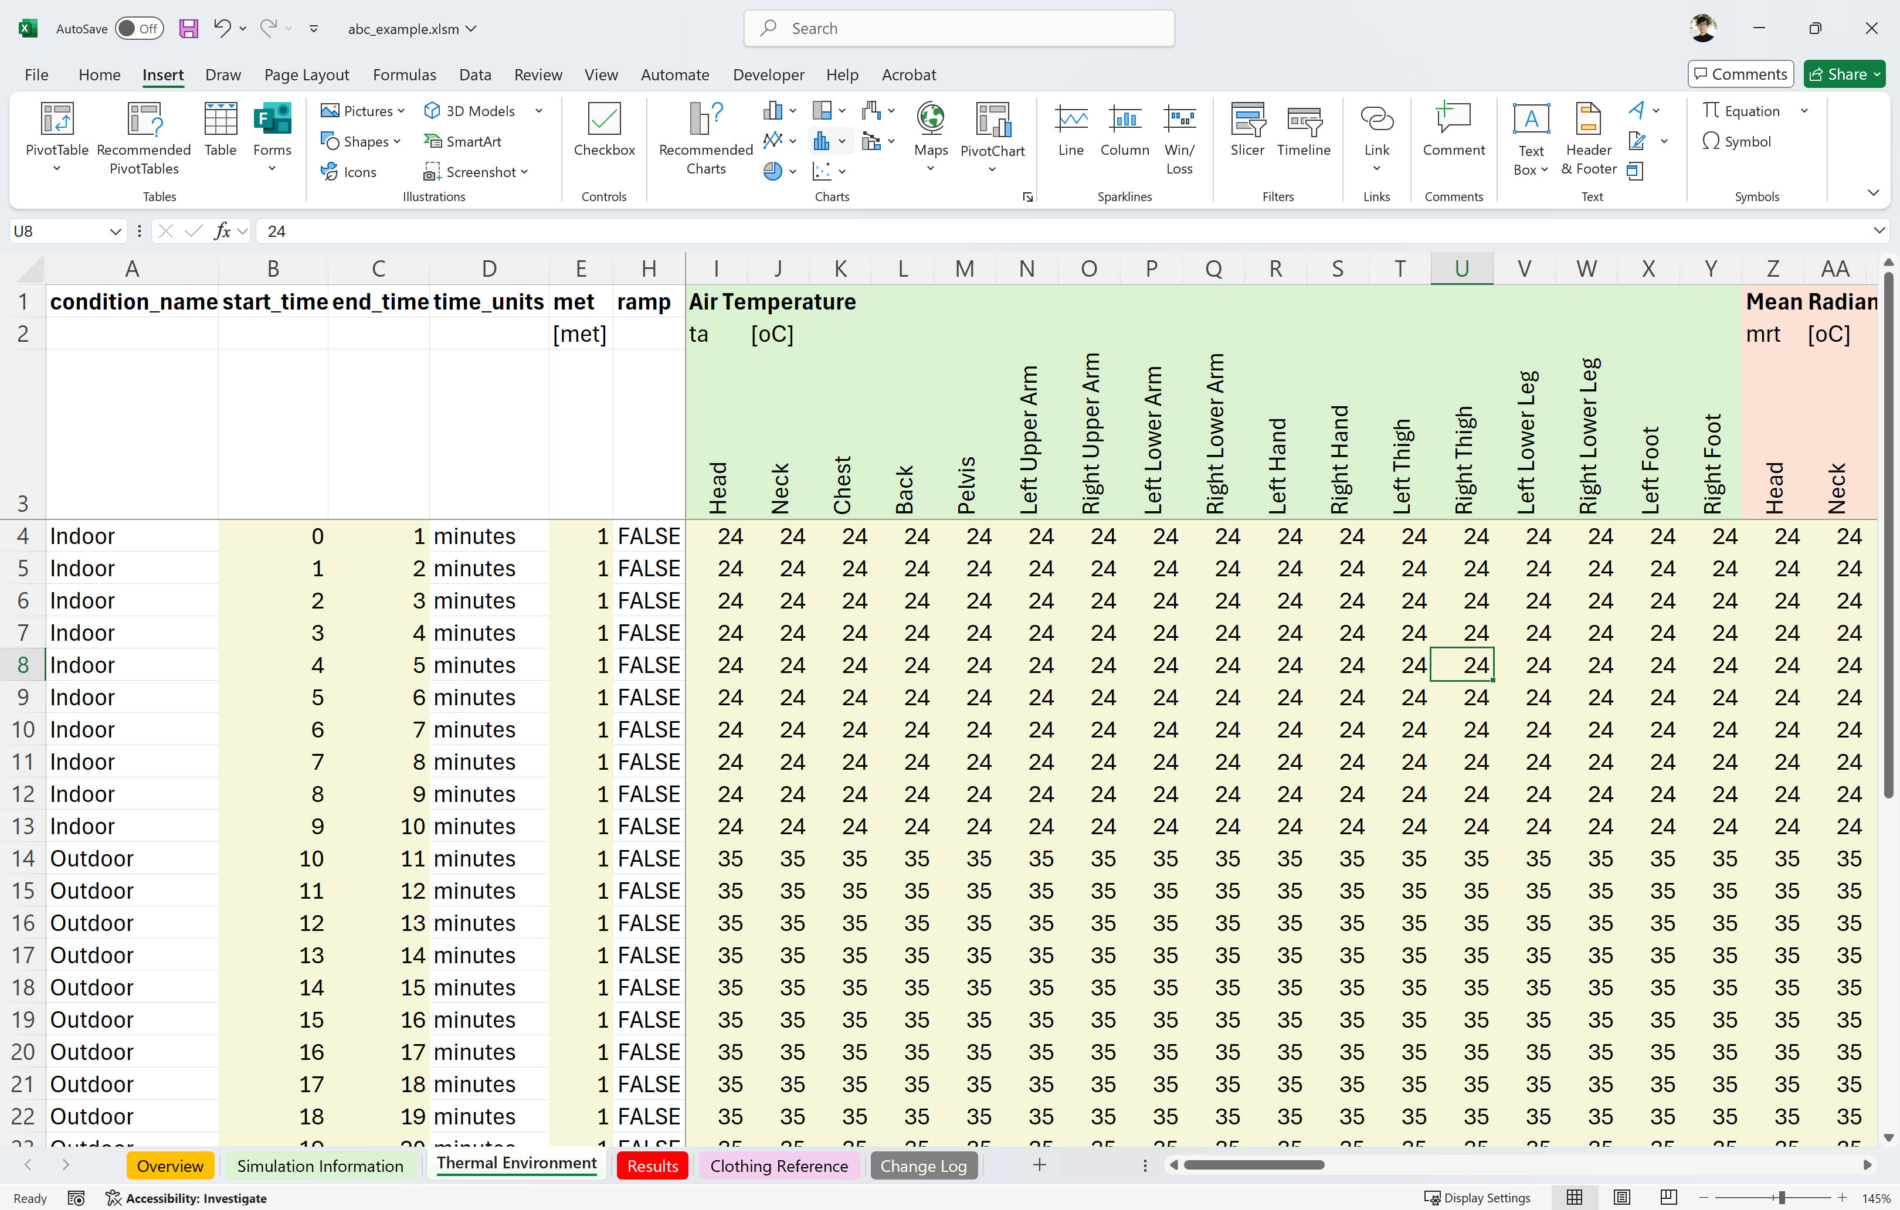
(a)
(b)

Slide 30

Body
Temp.
Receptor
CNS
Central Nervous System
Convection
Conduction
Heat Flow
Heat Production
Heat Flow
Feedback control
to keep body temp.
Termoregulation
Radiation
Evaporation
Sweating
Vasoconstriction
Vasodilation
Shivering
Heat Flow
Heat Flow
Passive System
Active System

